Slide 1
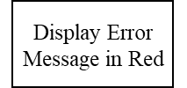
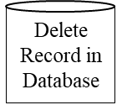


Start
Login Page, enter credentials
Increase counter of failed attempts by 1
If False
Check Credentials
If Incorrect Credentials Entered > 2
If True
Exit the application
If True
Select Stock Details of
Go Back
Enter New Stock Details Option and View Existing Stock Option
If New Stock Details Entered
Check Format and entries
If False
If View Existing Stocks option chosen
If True and database connectivity exists
Go Back
If False
Display all existing stocks from database sorted in ascending order of number of quantities left
Enter New Record in Database
If True
Database Connectivity
If Delete Existing Stock option chosen
Go Back
If Edit Existing Stocks option chosen
Go Back
Go Back
If False
Check Format and entries
If True and database connectivity exists

